Slide 1
Clustering text
Nisheeth

Slide 2
Overview
Quickly review clustering
Emphasizing cluster quality assessment
Introduce plate notation
Introduce text clustering algorithms
Focus on LDA
Useful reading: MC Burton’s intro to topic modeling
http://mcburton.net/blog/joy-of-tm/

Slide 3
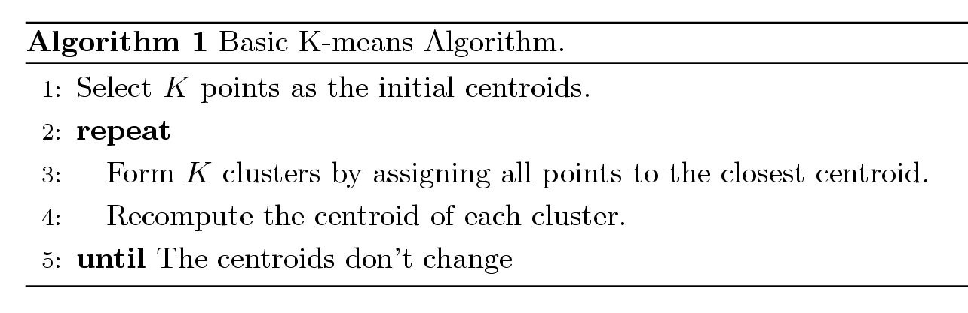
K means clustering
Exclusive clustering approach
Each cluster is associated with a centroid (center point)
Each point is assigned to the cluster with the closest centroid
Number of clusters, K, must be specified
The basic algorithm is very simple

Slide 4
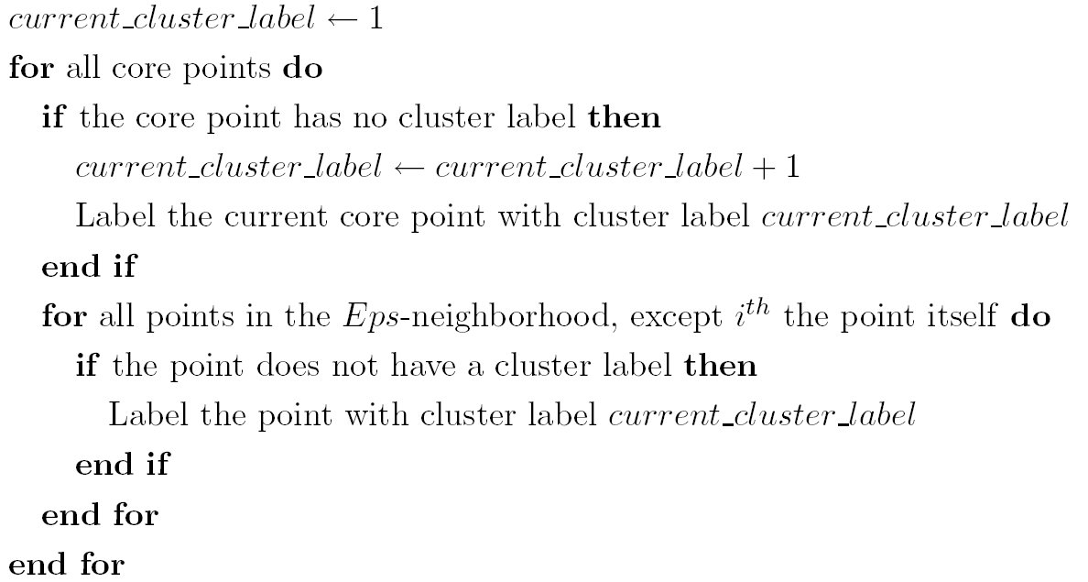
DBSCAN algorithm
Eliminate noise points
Perform clustering on the remaining points

Slide 5
Good result

Slide 6
Bad result

Slide 7
Quantifying clustering quality
Cluster Cohesion: Measures how closely related are objects in a cluster
Example: SSE
Cluster Separation: Measures how distinct or well-separated a cluster is from other clusters
Example: Squared Error
Cohesion is measured by the within cluster sum of squares (SSE)
Separation is measured by the between cluster sum of squares
Where |C_{i}| is the size of cluster i

Slide 8
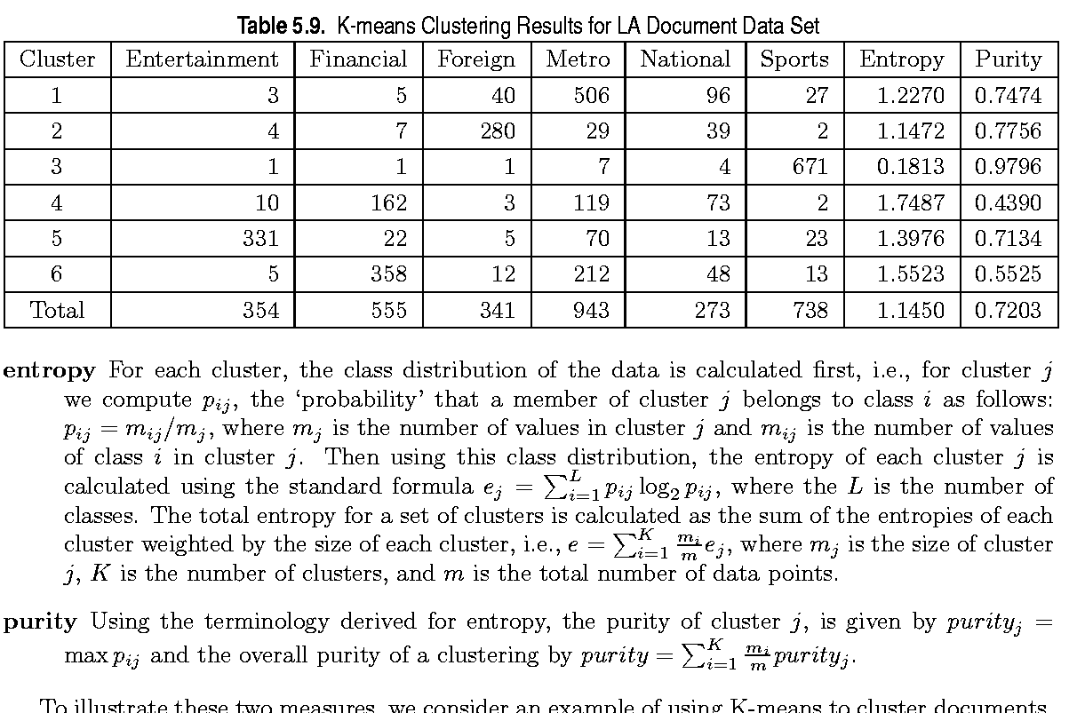
Quantifying clustering quality

Slide 9
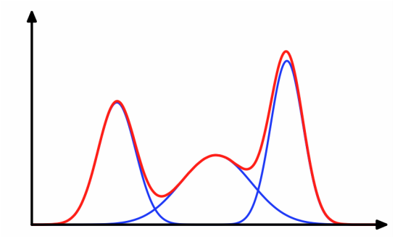
What does the model tell you?
With some probability, pick a Gaussian
With some probability, pick a point from the Gaussian
p(x)
G
x
K
x

Slide 10
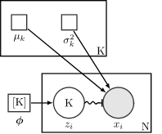
Shift to plate notation
[0.12, 0.08,…, 0.4]_{|K|}
T₁
T₂
T_{K}
x₁
x_{N}
x₁
x_{N}
x₁
x_{N}

Slide 11
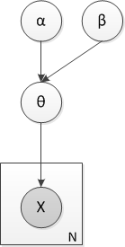
Coin toss example
Say you toss a coin N times
You want to figure out its bias
Bayesian approach
Find the generative model
Each toss ~ Bern(θ)
θ ~ Beta(α,β)
Draw the generative model in plate notation

Slide 12
Plate notation
Random variables as circles
Parameters, fixed values as squares
Repetitions of conditional probability structures as rectangular ‘plates’
Switch conditioning as squiggles
Random variables observed in practice are shaded

Slide 13
Conjugacy
Algebraic convenience in Bayesian updating
Posterior ← Prior x Likelihood
We want the distributions to be parametric, the parameter is what is learned
we want the posterior to have the same parametric form as the prior
Conjugate prior = f(.) such that f(θ)g(x|θ) ~ f(θ^{new})

Slide 14
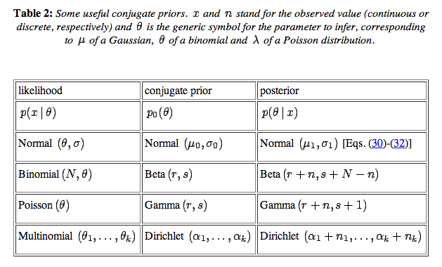
Useful conjugate priors
This one is important for us

Slide 15
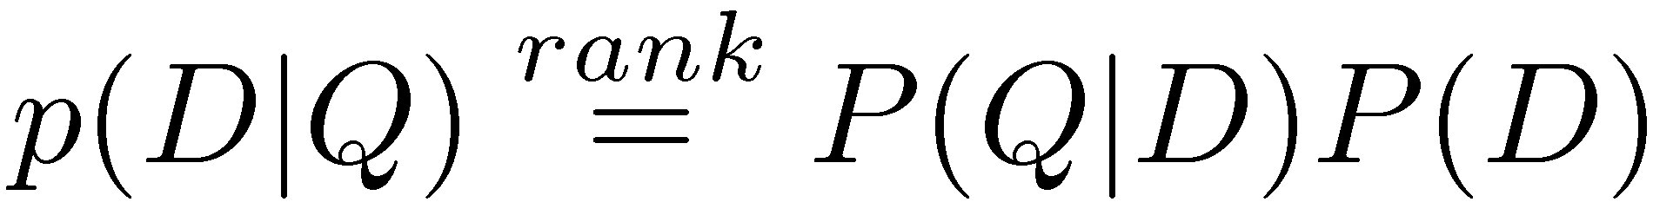
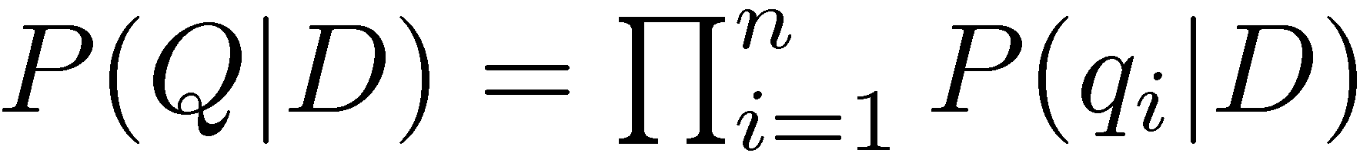
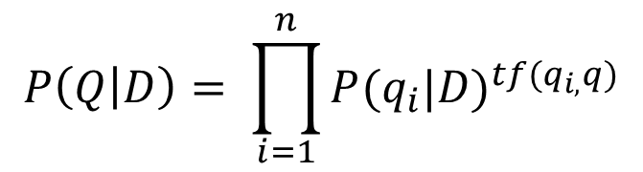
Remember the query-Likelihood model?
Rank documents by the probability that the query could be generated by the document model (i.e. same topic)
Given query, start with P(D|Q)
Using Bayes’ Rule
Assuming prior is uniform, unigram model
Alternative formulation: multinomial unigram model
$$P\left(Q | D\right)= \prod_{i=1}^{n}{{P(q_{i}|D)}^{tf(q_{i,}q)}}$$

Slide 16

Multinomial unigram model
Each word assumed generated from a single multinomial distribution
In plate notation
Probabilistic alternative to tf.idf
w
|d|
N
$$p\left(w\right)= \prod_{i=1}^{n}{p(w_{i})}$$

Slide 17
Going beyond tf.idf in text processing
D
D
T
q
q

Slide 18
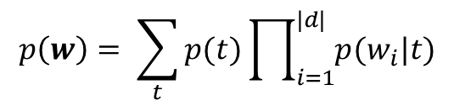
Mixture of unigrams
Document label generated from a topic
Words generated from topic-specific word distributions
Strong assumption: one document generated from one topic only
t
w
$$p\left(w\right)= \sum_{t}{p(t)\prod_{i=1}^{|d|}{p(w_{i}|t)}}$$
|d|
N

Slide 19
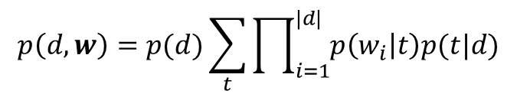
Probabilistic latent semantic analysis
Assume topics are drawn from documents
Assume words are drawn from topics
d
t
w
|d|
N
$$p\left(d,w\right)=p(d)\sum_{t}{\prod_{i=1}^{|d|}{p\left(w_{i} | t\right)p(t|d)}}$$

Slide 20
Problem of PLSI
Mixture weights are considered as document specific, thus no natural way to assign probability to a previously unseen document.
Number of parameters to be estimated grows linearly with size of training set
overfits data
multiple local maxima.
Not a fully generative model of documents.

Slide 21
Latent Dirichlet allocation
LDA is a generative probabilistic model of a corpus.
Documents are considered random mixtures over latent topics
Topic are characterized by a distribution over words.

Slide 22
LDA in plate notation
d
t
w
|d|
N

Slide 23
LDA in plate notation
θ
t
w
|d|
N

Slide 24
LDA in plate notation
α
θ
t
w
|d|
N

Slide 25
LDA in plate notation
ψ
α
θ
t
w
|d|
N

Slide 26
LDA in plate notation
ψ
K
α
θ
t
w
|d|
N

Slide 27
LDA in plate notation
β
ψ
K
α
θ
t
w
|d|
N

Slide 28
Generative model
For all documents
Generate θ ~ Dirichlet(α)
Generate all K ψ ~ Dirichlet(β)
For all words in each document
Generate t ~ Multinomial(θ)
Generate w ~ Multinomial(ψ_{t})

Slide 29
LDA math – the Dirichlet distribution
A k-dimensional Dirichlet random variable θ can take values in the (k-1)-simplex, and has the following probability density on this simplex:
Easier to understand
Prior Dir(α_{1,} α₂)
Likelihood Multi(θ₁ , θ₂)
Outcome {n₁, n₂}
Posterior Dir(α₁+ n₁, α₂ + n₂)
Ignoring the normalization constant, what is the Dirichlet probability of a multinomial sample [0.1, 0.5, 0.4] with parameter 10
(0.1)⁹ (0.5)⁹ (0.4)⁹ = 5e-16
What would it be for parameter 0.2?
22

Slide 30
β
Dirichlet
ψ
K
α
Dirichlet
θ
t
w
|d|
N

Slide 31
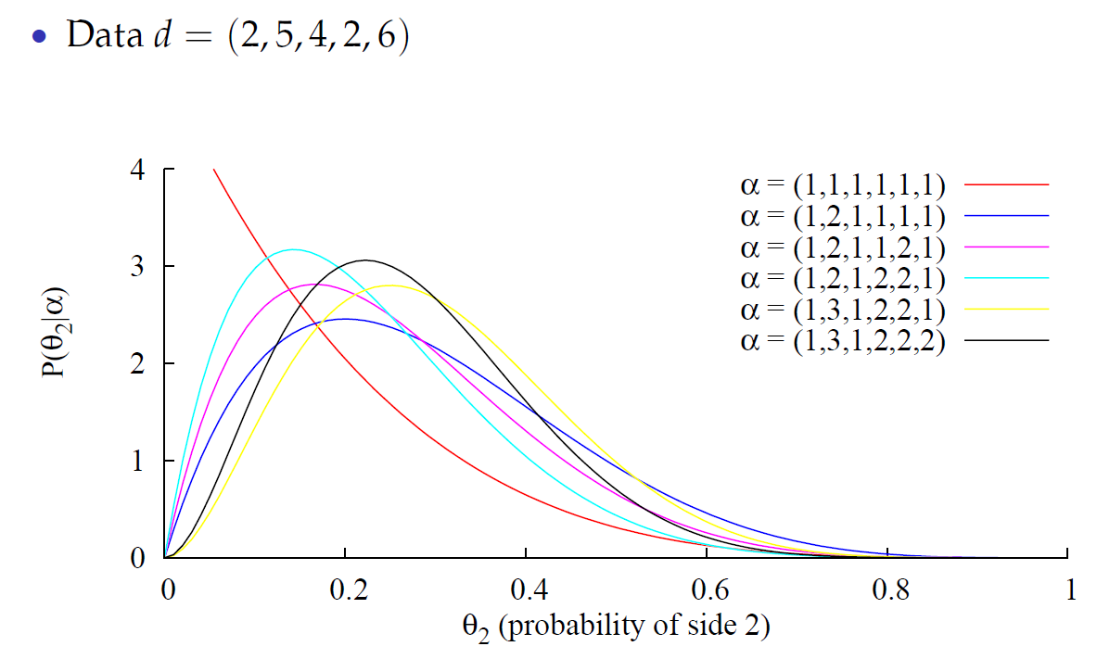
Dirichlet update – dice roll

Slide 32
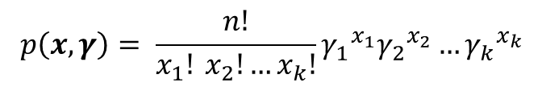
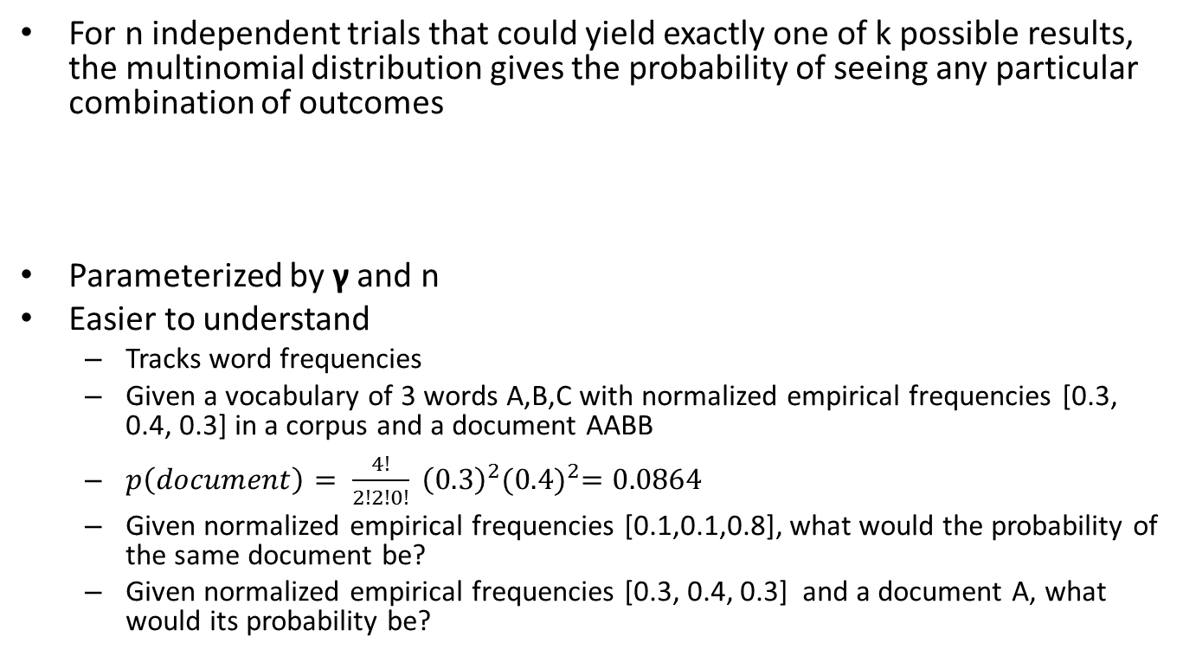
LDA math – the multinomial distribution
For n independent trials that could yield exactly one of k possible results, the multinomial distribution gives the probability of seeing any particular combination of outcomes
Parameterized by γ and n
Easier to understand
Tracks word frequencies
Given a vocabulary of 3 words A,B,C with normalized empirical frequencies [0.3, 0.4, 0.3] in a corpus and a document AABB
$p\left(document\right)= \frac{4!}{2!2!0!} {\left(0.3\right)}^{2}{(0.4)}^{2}=0.0864$
Given normalized empirical frequencies [0.1,0.1,0.8], what would the probability of the same document be?
Given normalized empirical frequencies [0.3, 0.4, 0.3] and a document A, what would its probability be?
$$p\left(x,γ\right)= \frac{n!}{x_{1}! x_{2}!…x_{k}!}{γ_{1}}_{}^{x_{1}}{γ_{2}}_{}^{x_{2}}…{γ_{k}}_{}^{x_{k}}$$

Slide 33
β
ψ
K
Multinomial
α
θ
t
w
Multinomial
|d|
N
p(w|t) is high when many words in a document show up as high frequency terms in the corresponding topic word distribution
ψ is distribution of words in a topic
p(t|θ) is high when many words in a topic show up as high frequency terms in the document topic distribution
θ is distribution of topics in a document

Slide 34
Compare with Gaussian mixture model
p(K|φ) is high when the φ value is high for the K^{th} label
p(x|K) is high when x is statistically likely to be drawn from the Gaussian with the Kth summary statistics

Slide 35
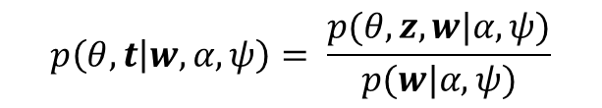
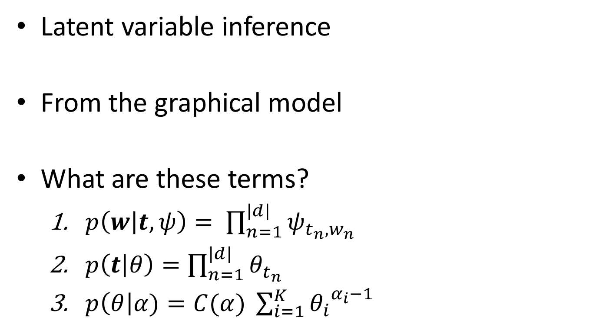
LDA inference
Latent variable inference
From the graphical model
What are these terms?
$p\left(w | t,ψ\right)= \prod_{n=1}^{|d|}{ψ_{t_{n}, w_{n}}}$
$p\left(t | θ\right)=\prod_{n=1}^{|d|}{θ_{t_{n}}}$
$p\left(θ\right|α)=C(α) \sum_{i=1}^{K}{{θ_{i}}^{α_{i}−1}}$
$$p\left(θ,t | w,α,ψ\right)= \frac{p(θ, z,w|α, ψ)}{p(w|α, ψ)}$$
$$p\left(θ,z,w | α,ψ\right)=p\left(w | t,ψ\right)p\left(t | θ\right)p\left(θ | α\right)$$

Slide 36
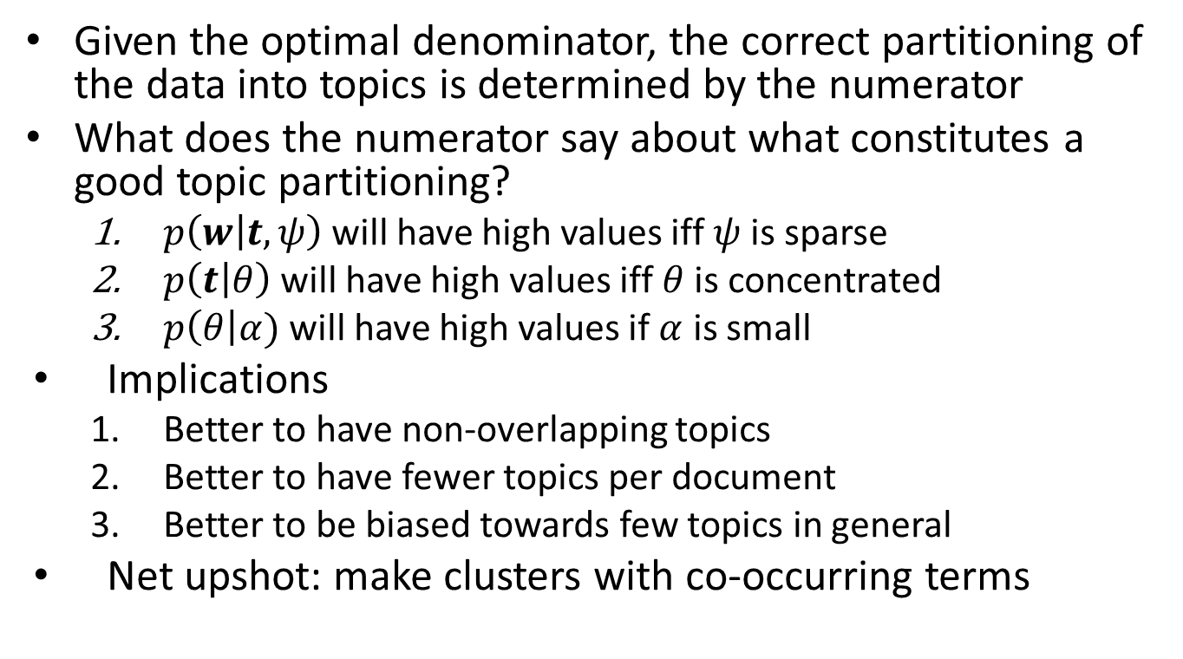
LDA intuition
Given the optimal denominator, the correct partitioning of the data into topics is determined by the numerator
What does the numerator say about what constitutes a good topic partitioning?
$p\left(w | t,ψ\right)$ will have high values iff $ψ$ is sparse
$p\left(t | θ\right)$ will have high values iff $θ$ is concentrated
$p\left(θ\right|α)$ will have high values if $α$ is small
Implications
Better to have non-overlapping topics
Better to have fewer topics per document
Better to be biased towards few topics in general
Net upshot: make clusters with co-occurring terms

Slide 37
LDA inference
From these building blocks we get the full numerator
Denominator obtained by marginalizing over the latent variables
Involves an intractable integral
Have to use approximate inference methods
Variational EM
Gibbs sampling
MLE inference is standard

Slide 38
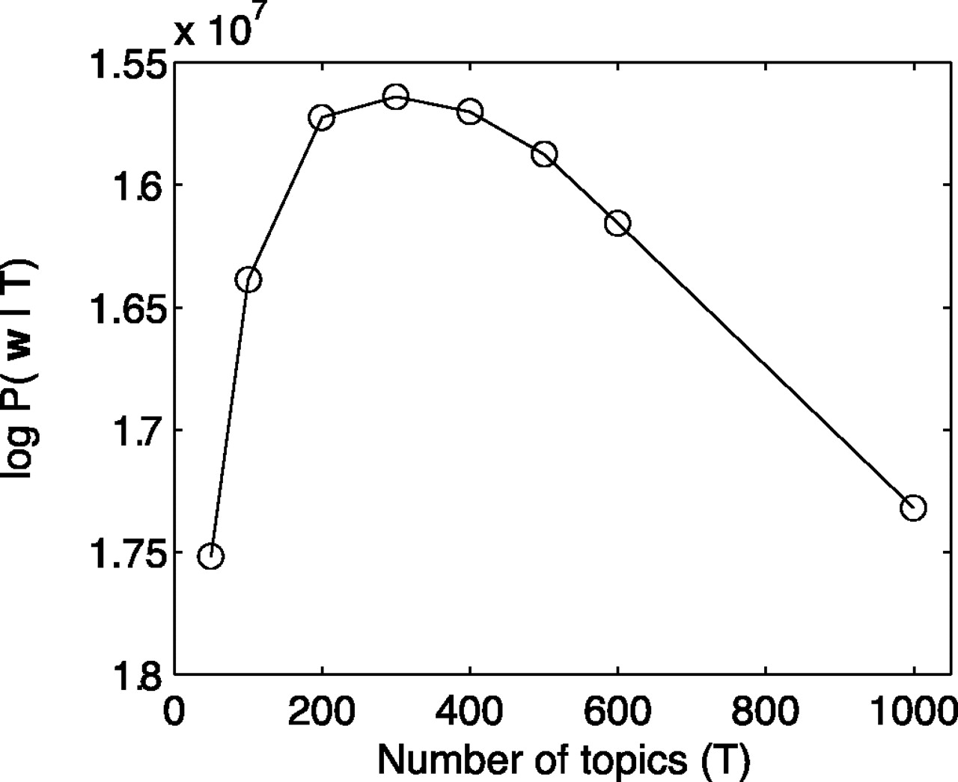
Model selection

Slide 39
Document modeling
Unlabeled data – our goal is density estimation.
Compute the perplexity of a held-out test to evaluate the models – lower perplexity score indicates better generalization.
.

Slide 40
Document Modeling – cont. data used
C. Elegans Community abstracts
5,225 abstracts
28,414 unique terms
TREC AP corpus (subset)
16,333 newswire articles
23,075 unique terms
Held-out data – 10%
Removed terms – 50 stop words, words appearing once (AP)

Slide 41
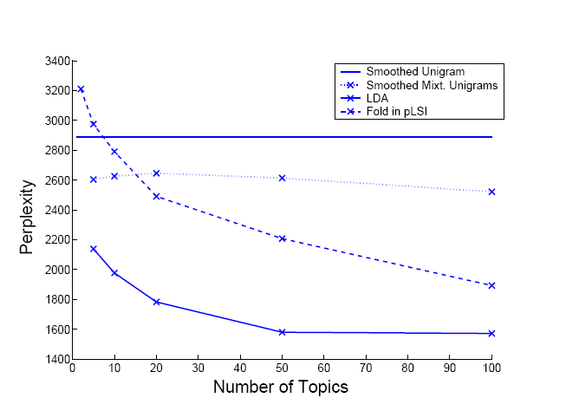
nematode

Slide 42
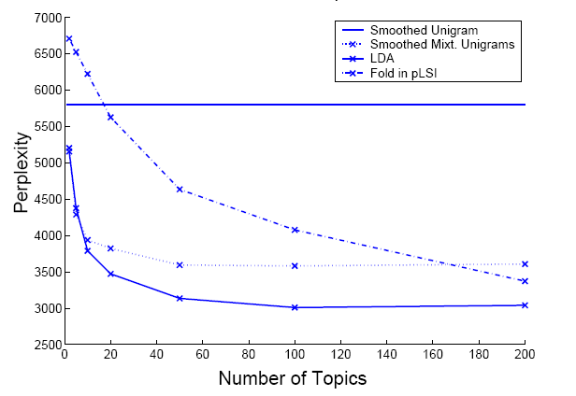
AP

Slide 43
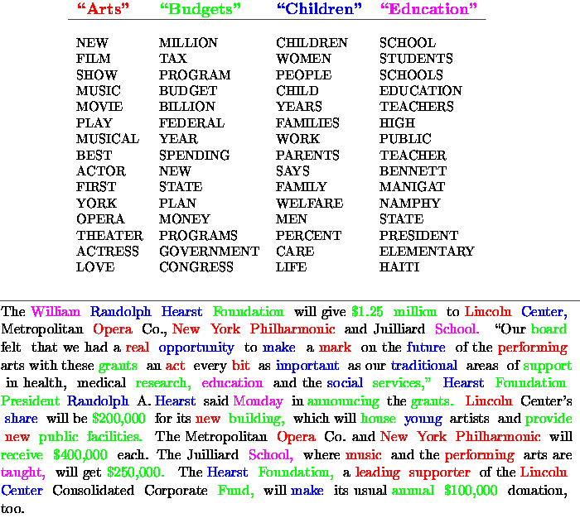
What can you get from it?

Slide 44
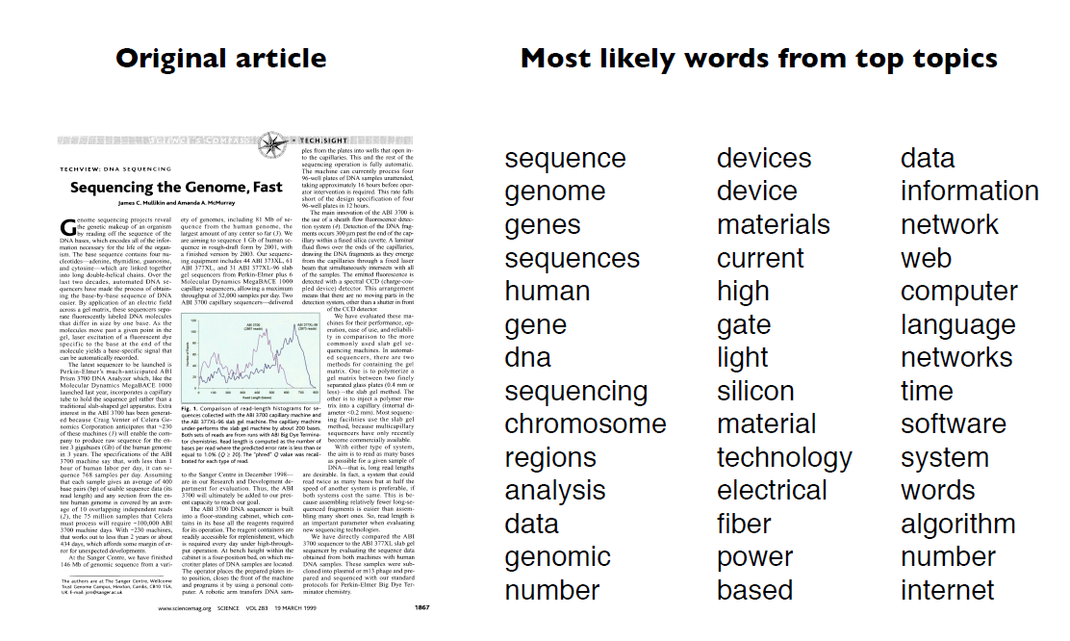
Topic membership

Slide 45
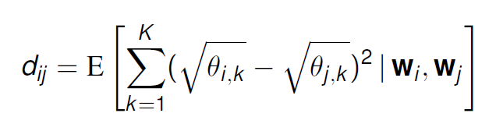
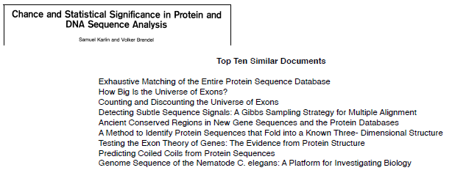
Document similarity

Slide 46
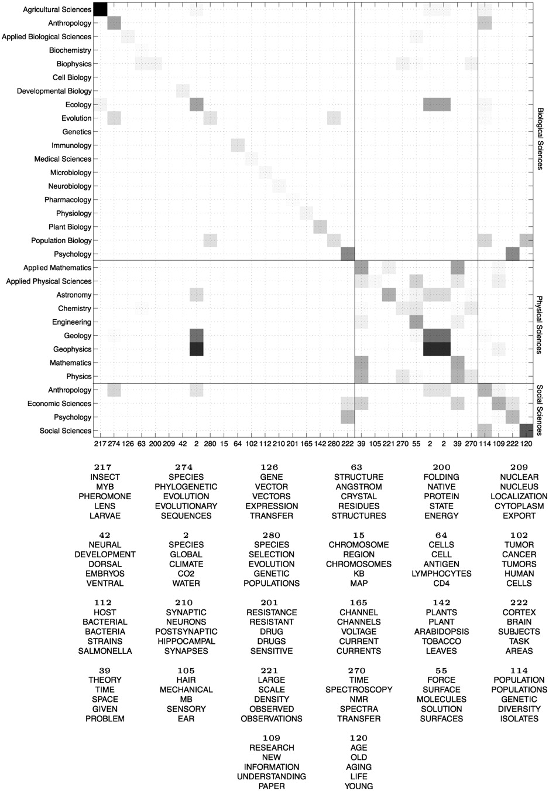
Topic similarity
Thomas L. Griffiths, and Mark Steyvers PNAS 2004;101:5228-5235
©2004 by National Academy of Sciences
Notes:
(Upper) Mean values of θ at each of the diagnostic topics for all 33 PNAS minor categories, computed by using all abstracts published in 2001. Higher probabilities are indicated with darker cells. (Lower) The five most probable words in the topics themselves listed in the same order as on the horizontal axis in Upper.

Slide 47
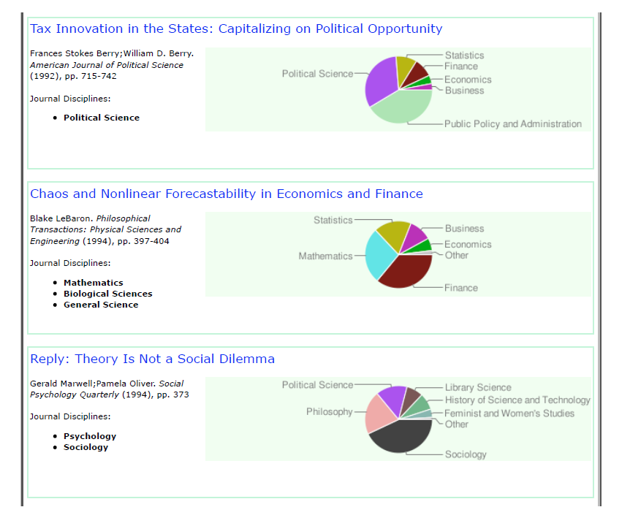
Document tagging, relevance scoring

Slide 48
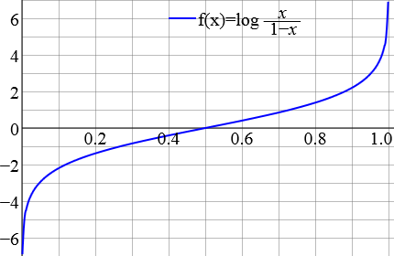


Extension: correlated topic models
Logit plot
β
ψ
K
Σ
θ
t
w
μ
|d|
N
$$x \sim N\left(μ, Σ\right)$$
$$θ∝exp⁡(x_{i})$$

Slide 49
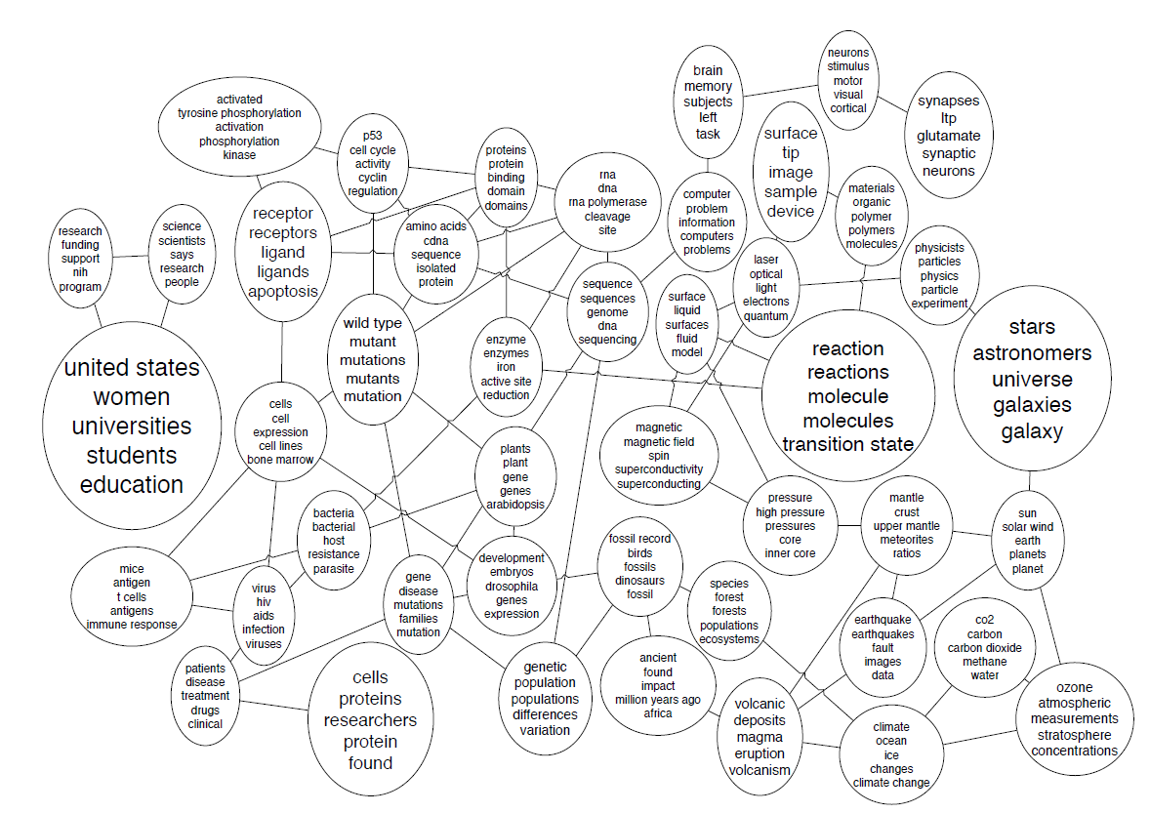
Topic hierarchies

Slide 50
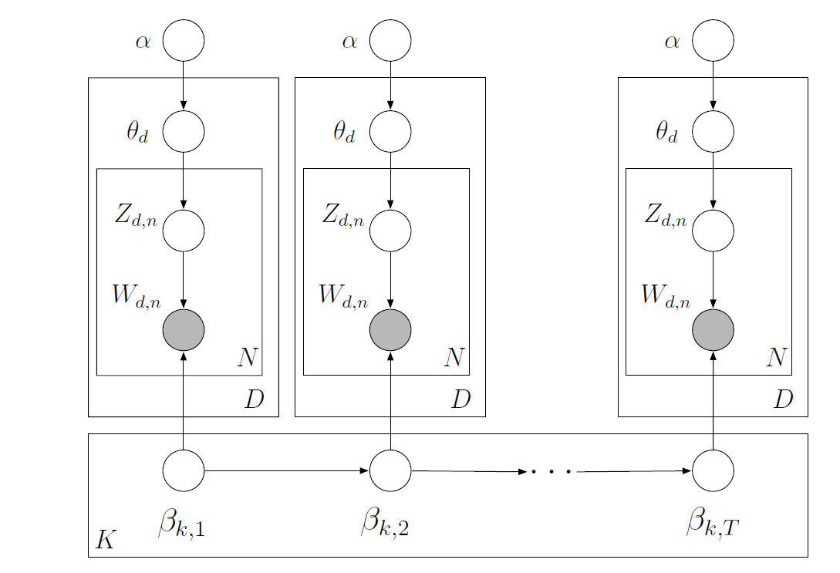
Extension: dynamic topic modeling

Slide 51
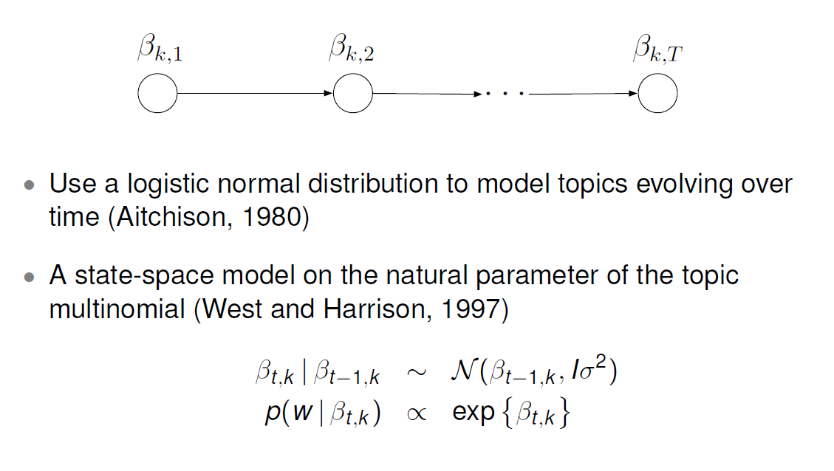
Time-drifting topic distributions

Slide 52
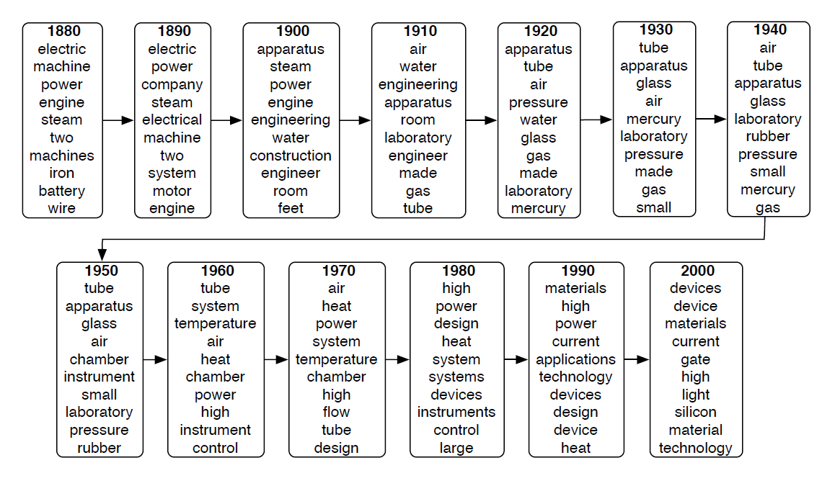
Temporal changes

Slide 53
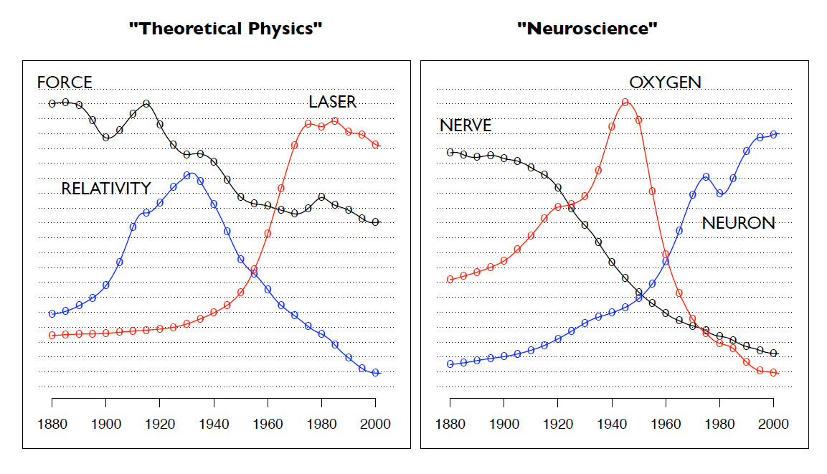
Trends

Slide 54
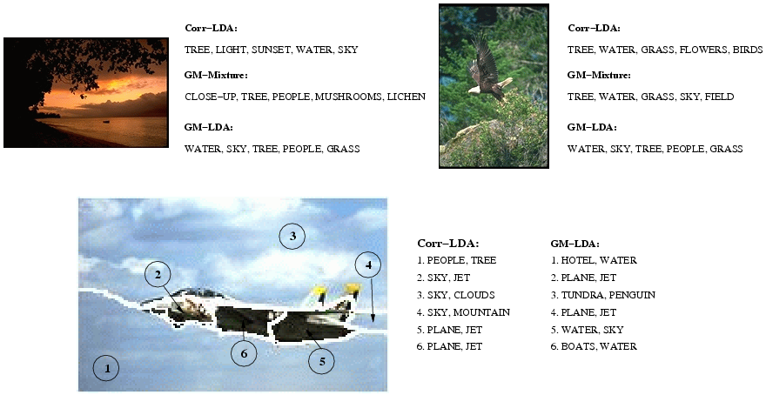
Other uses

